Slide 1
Moore=Mealy
Shakir Ullah Shah

Slide 2
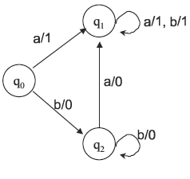
Moore Machine

Slide 3
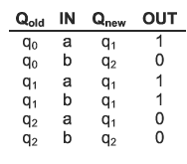

Slide 4
Applications of Incrementing and Complementing machines
1’s complementing and incrementing machines which are basically Mealy machines are very much helpful in computing.
The incrementing machine helps in building a machine that can perform the addition of binary numbers.
Using the complementing machine along with incrementing machine, one can build a machine that can perform the subtraction of binary numbers.

Slide 5
Equivalent machines
Two machines are said to be equivalent if they print the same output string when the same input string is run on them.
Two Moore machines may be equivalent. Similarly two Mealy machines may also be equivalent, but
A Moore machine can’t be equivalent to any Mealy machine. However, ignoring the extra character printed by the Moore machine, there exists a Mealy machine which is equivalent to the Moore machine.

Slide 6
Theorem 8
Statement:
For every Moore machine there is a Mealy machine that is equivalent to it (ignoring the extra character printed by the Moore machine).

Slide 7
Theorem 8
If Mo is a Moore machine, then there is a Mealy machine Me that is equivalent to Mo.
Proof by constructive algorithm:
Consider a particular state in Mo, say state q₄, which prints a certain character, say t.
Consider all the incoming edges to q₄. Suppose these edges are labeled with a, b, c, ...
Let us re-label these edges as a/t, b/t, c/t, ... and let us erase the t from inside the state q₄. This means that we shall be printing a t on the incoming edges before we enter q₄.

Slide 8
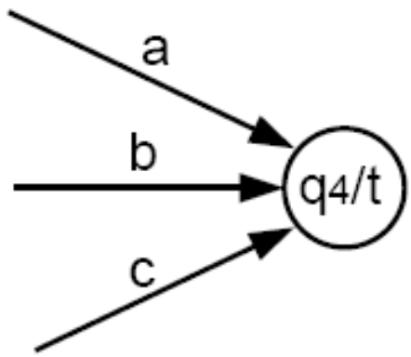
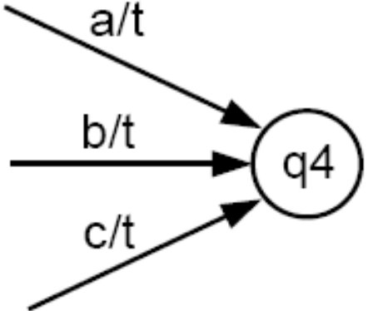
Proof by constructive algorithm contd.
becomes
We leave the outgoing edges from q₄ alone. They will be relabeled to print the character associated with the state to which they lead.
If we repeat this procedure for every state q₀, q₁, ..., we turn Mo into its equivalent Me.

Slide 9
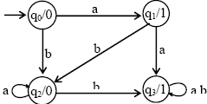
Moore to mealy

Slide 10
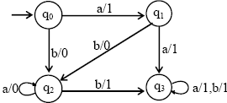
Moore to mealy

Slide 11
Running the string abbabbba on both
Input |  | a | b | b | a | b | b | b | a
States | q0 | q1 | q2 | q3 | q3 | q3 | q3 | q3 | q3
Moore | 0 | 1 | 0 | 1 | 1 | 1 | 1 | 1 | 1
Mealy |  | 1 | 0 | 1 | 1 | 1 | 1 | 1 | 1

Slide 12
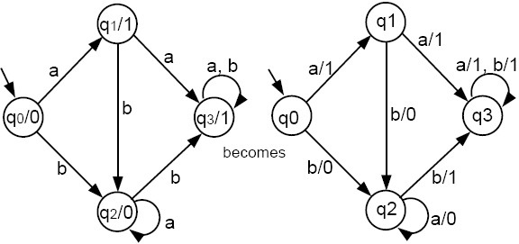
Example
Following the above algorithm, we convert a Moore machine into a Mealy machine as follows:

Slide 13
Theorem 9
Statement:
For every Mealy machine there is a Moore machine that is equivalent to it (ignoring the extra character printed the Moore machine).

Slide 14
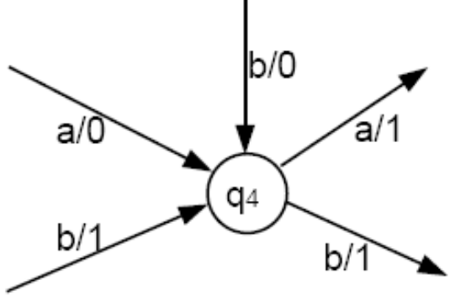
Theorem 9
If Me is a Mealy machine, then there is a Moore machine Mo that is equivalent to Me.
Proof by constructive algorithm:
We cannot just do the reverse of the previous algorithm. If we try to push the printing instruction from the edge (as it is in Me) to the inside of the state (as it should be for Mo), we may end up with a conflict: Two edges may come into the same state but have different printing instructions, as in this example:

Slide 15
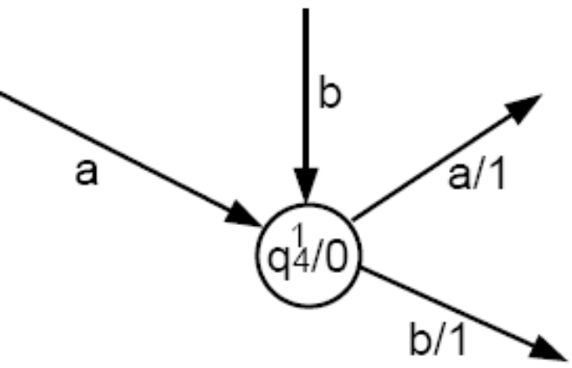
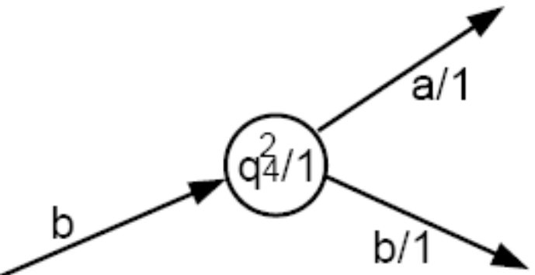
Proof by constructive algorithm (cont.):
What we need are two copies of q₄, one that prints a 0 (labeled as q¹₄/0), and the other that prints a 1 (labeled as q²₄/1). Hence,
  – The edges a/0 and b/0 will go into q¹₄/0.
  – The edge b/1 will go into q²₄/1.
The arrow coming out of each of these two copies must be the same as the edges coming out of q₄ originally.

Slide 16
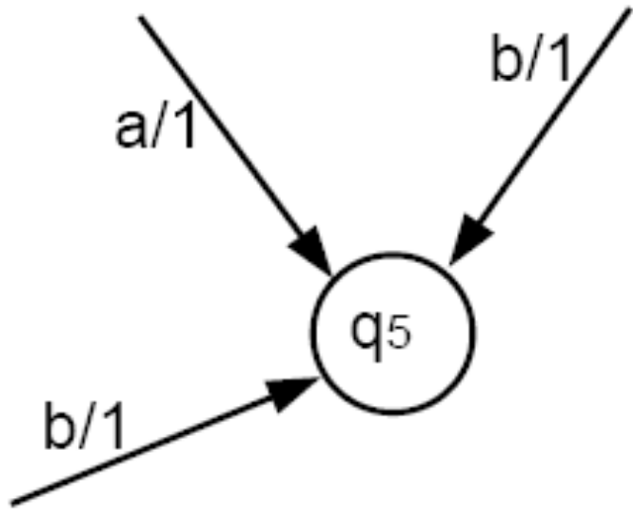
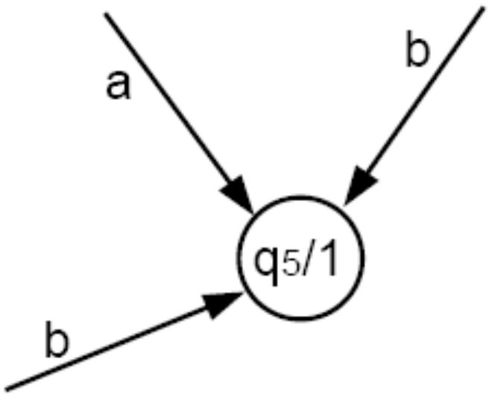
Proof by constructive algorithm (cont.):
If all the edges coming into a state have the same printing instruction, we simply push that printing instruction into the state.
becomes

Slide 17
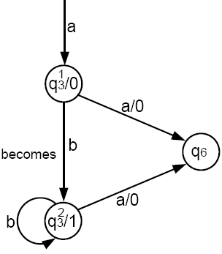
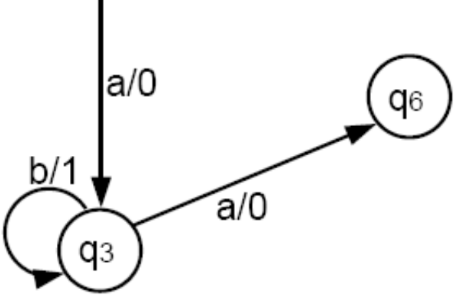
Proof by constructive algorithm (cont.):
An edge that was a loop in Me may becomes two edges in Mo, one that is a loop and one that is not.
becomes

Slide 18
Proof by constructive algorithm (cont.):
If there is ever a state that has no incoming edges, we can assign it any printing instruction we want, even if this state is the start state.
If we have to make copies of the start state in Me, we can let any of the copies be the start state in Mo, because they all give the identical directions for proceeding to other states.
Having a choice of start states means that the conversion of Me into Mo is NOT unique.
Repeating this process for each state of Me will produce an equivalent Mo. The proof is completed.
Together, Theorems 8 and 9 allow us to say Me = Mo.

Slide 19
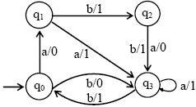
Example
Consider the following Mealy machine

Slide 20
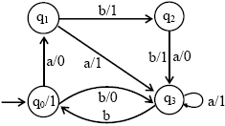
Example cont…
Shifting the output character 1 of transition b to q0

Slide 21
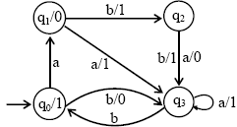
Example cont…
Shifting the output character 0 of transition a to q1

Slide 22
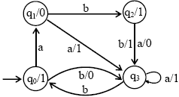
Example cont…
Shifting the output character 1 of transition b to q2

Slide 23
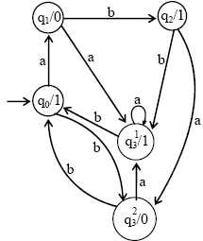
Example cont…
Splitting q3 into q₃¹ and q₃²

Slide 24
Running the string abbabbba on both
Input |  | a | b | b | a | b | b | b | a
States | q0
Mealy
Moore

Slide 25
Running the string abbabbba on both
Input |  | a | b | b | a | b | b | b | a
States | q0 | q1 | q2 | q3 | q3 | q0 | q3 | q0 | q1
Mealy |  | 0 | 1 | 1 | 1 | 1 | 0 | 1 | 0
Moore | 1 | 0 | 1 | 1 | 1 | 1 | 0 | 1 | 0

Slide 26
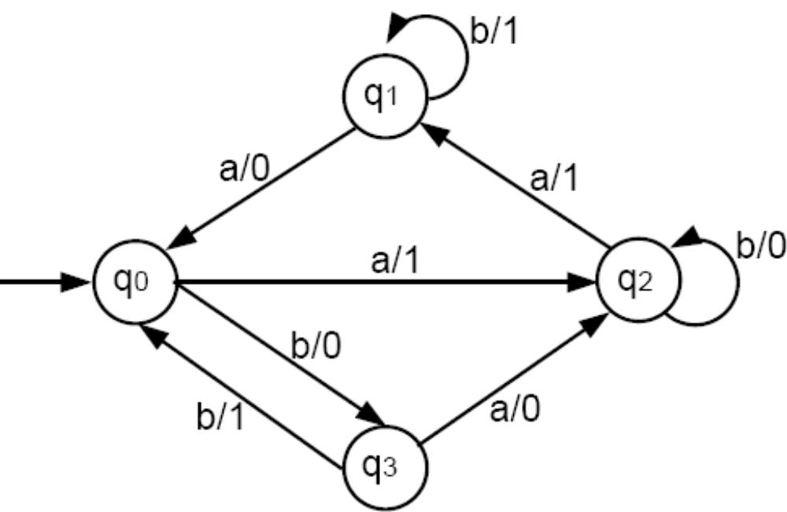
Example
Convert the following Mealy machine into a Moore machine:

Slide 27
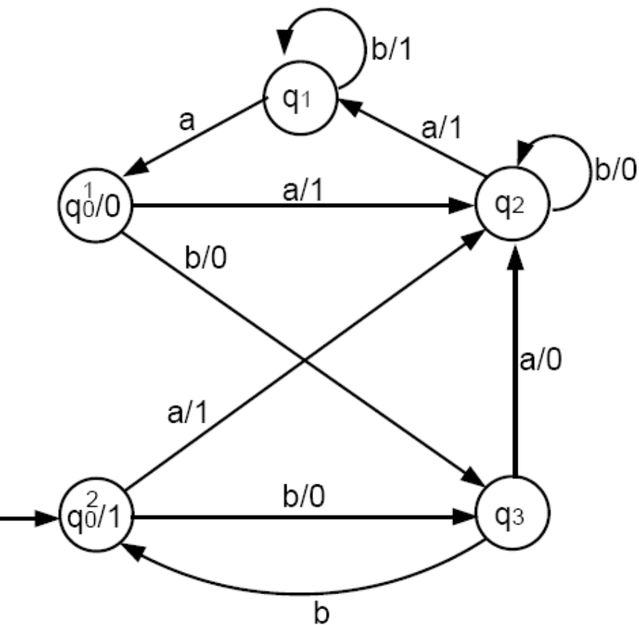
Example contd.
Following the algorithm, we first need two copies of q₀:

Slide 28
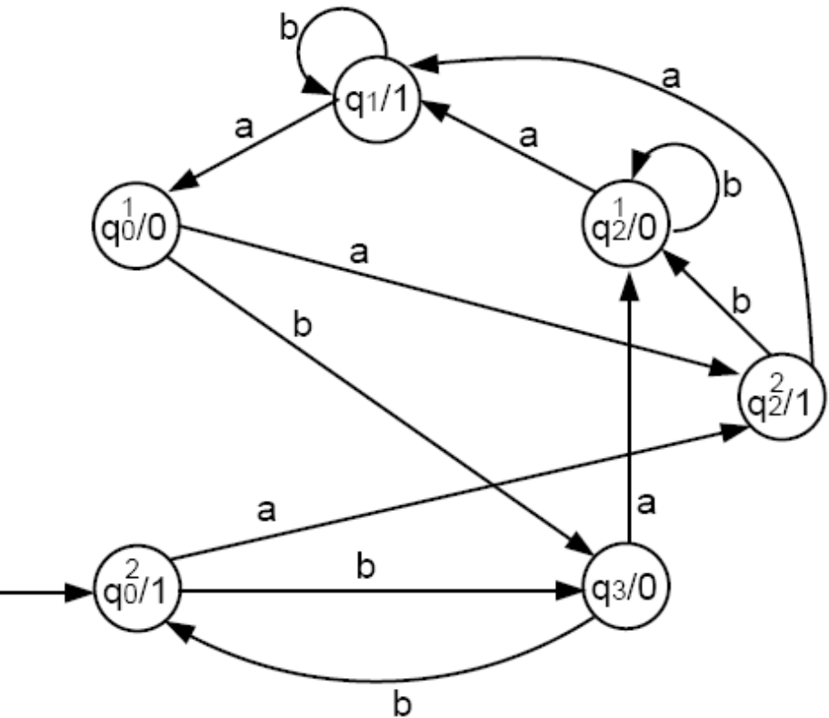
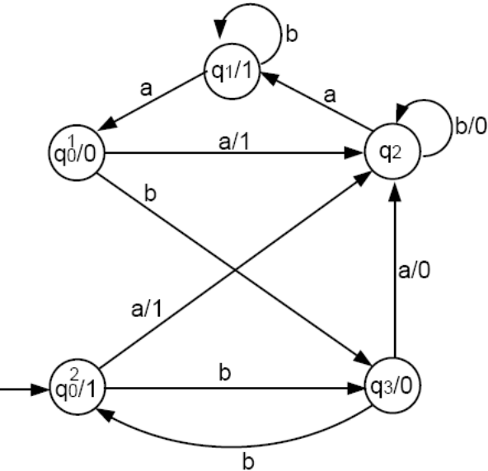
Example contd.
The only job left is to convert state q₂. There are 0-printing edges and 1-printing edges coming into q₂. So, we need two copies of q₂. The final Moore machine is:

Slide 29
Equivalence of Machines
Every Moore machine can be turned into a Mealy Machine
Every Mealy machine can be turned into a Moore Machine
Every regular language can be defined by Moore or a Mealy Machine
All languages defined by a Moor or a Mealy machine are regular.

